Slide 1


Crop tool
Text tool
IMPORTANT: click once to use text – don’t drag a text box out
A

Slide 2


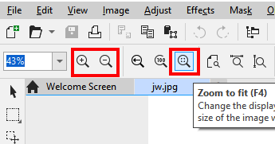
Pick tool
Switch to the pick tool to move objects around
Zoom tool
Switch between zoom in and out at the top
Zoom to fit is really useful

Slide 3
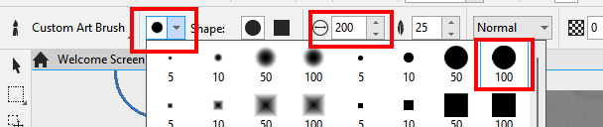
Change the size of the brush at the top – use the round 100 brush and make it bigger using the box highlighted
Brush Tool
Black brush to reveal
White brush to conceal
Swap with the double arrow
Colour control

Slide 4

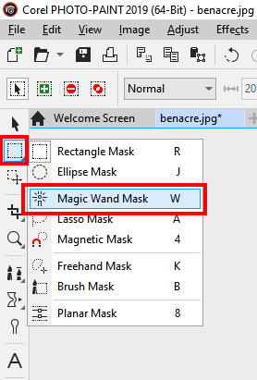
Magic Wand Mask
Under the Rectangle Mask
Click and hold on the Rectangle to select the Magic Wand Mask
Used to select areas of an image
Hold Control down on the keyboard to add to the selection
Keep holding Control to remove selected areas

