Slide 1
CD Covers – selective colour
In a list of the 50 “greatest” album covers*, 23 make really bold use of colour
Sometimes this colour is used selectively
*Billboard website. Which is American

Slide 2
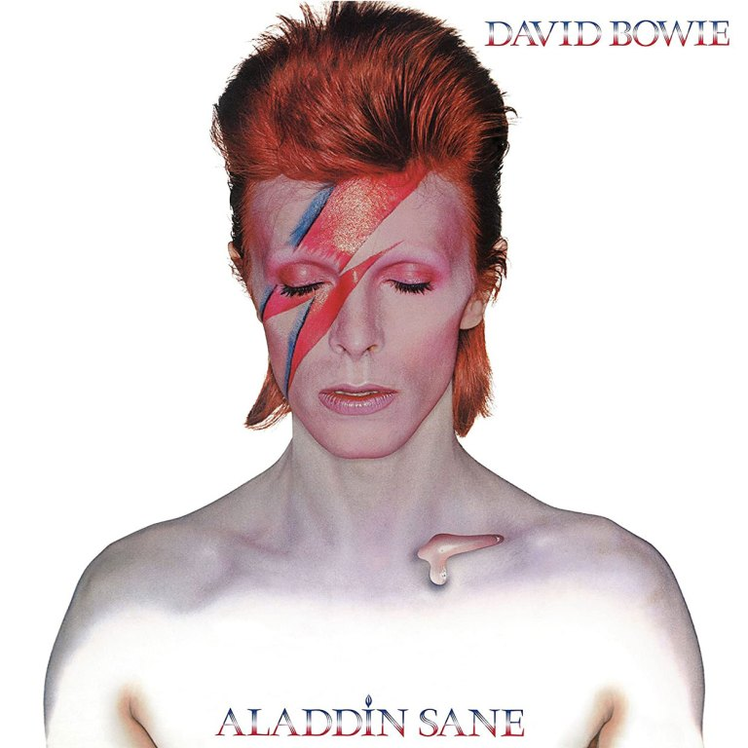
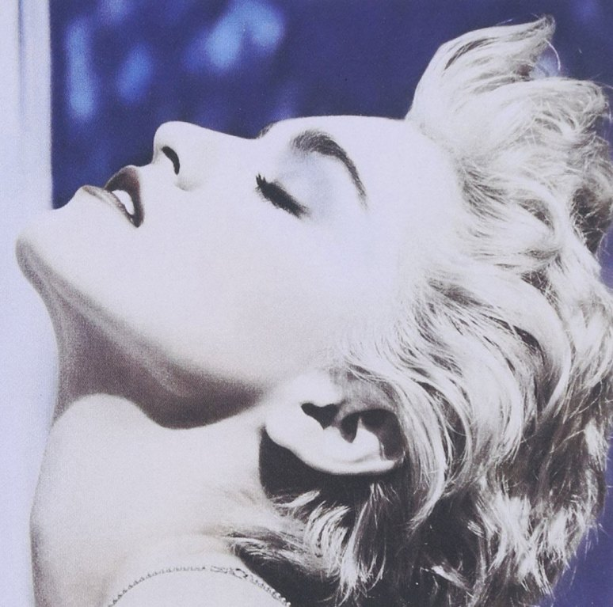
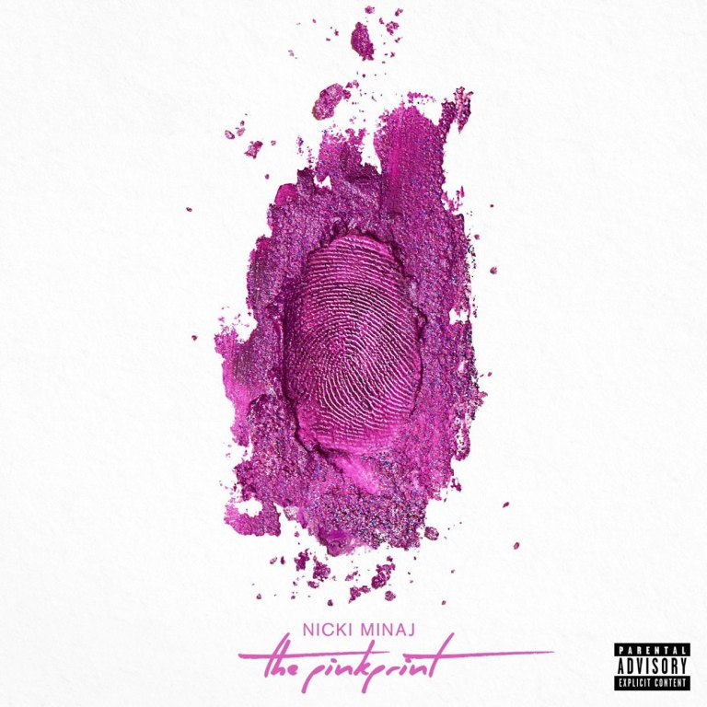

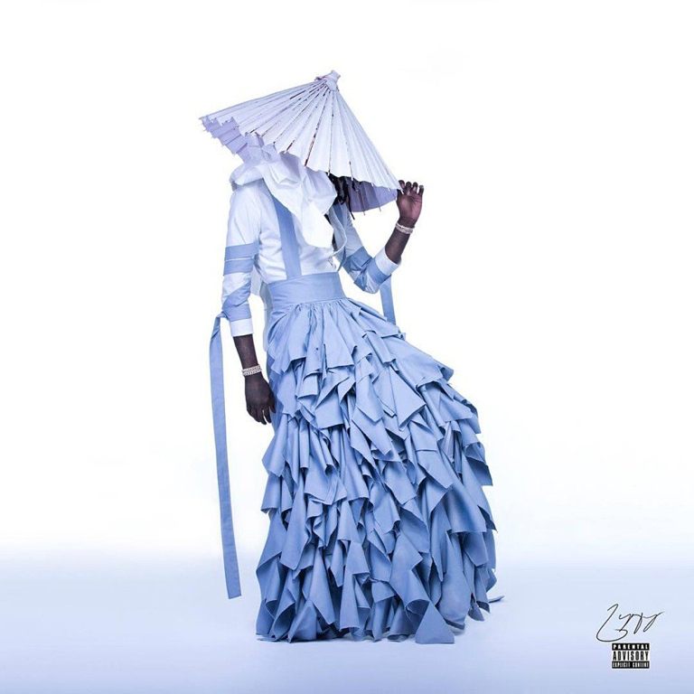

Slide 3
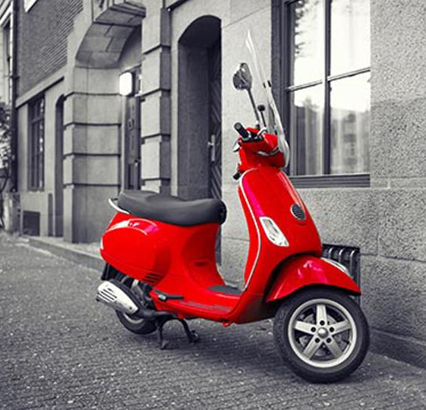
Selective colour
Selective colour makes only one part or one colour in a picture coloured

Slide 4
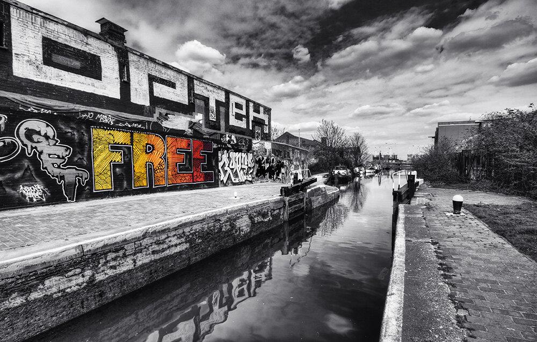


Selective colour
It can be used to make images more dynamic and interesting

Slide 5
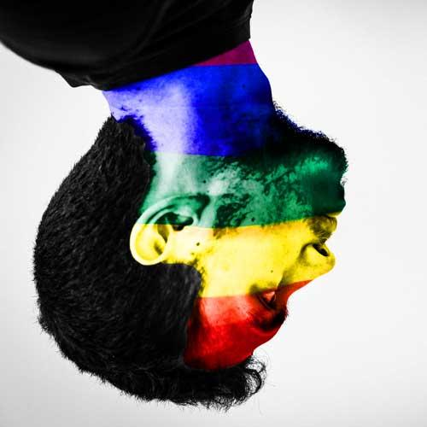
Overlay layers
An overlay can be used to add one image on top of another, using partial transparency

Slide 6
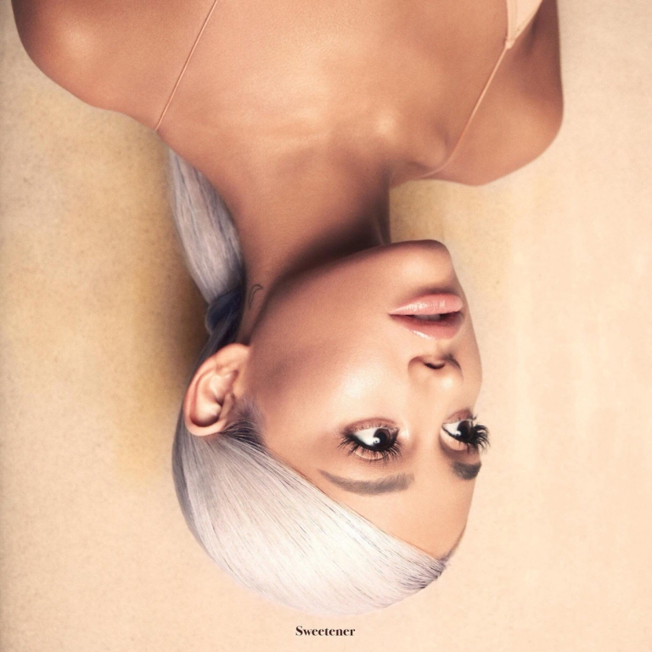

Slide 7
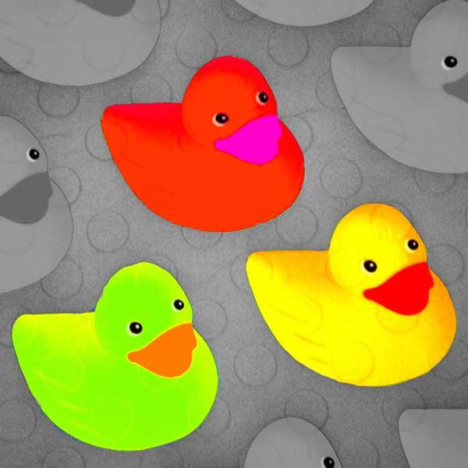
Selective colour & overlays
To create a “great” album cover using these skills you need to:
square crop the image
know how to use the brush tool to pick out colours
know how to add an overlay layer and edit it
add text

Slide 8
Album artwork is used in these slides at small sizes for educational use only.
No claim on copyright is made.

