Slide 1
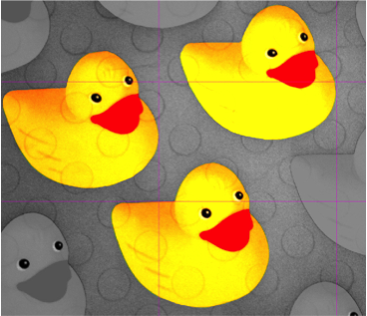
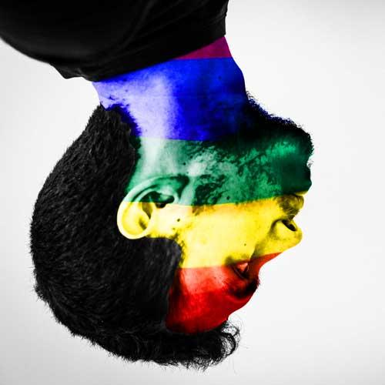
More colour – order of work
Make sure you square crop each time
Selective colour – ducks image
Colour overlay – the head
Make sure you add text, save and then export

