Slide 1
CD Covers – using colour
In a list of the 50 “greatest” album covers*, 23 make really bold use of colour
*Billboard website. Which is American

Slide 2
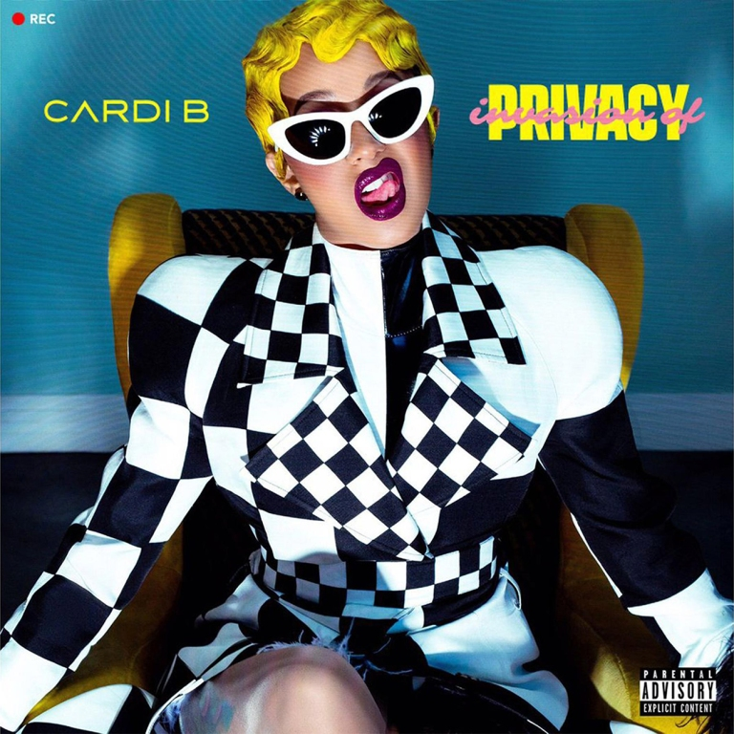
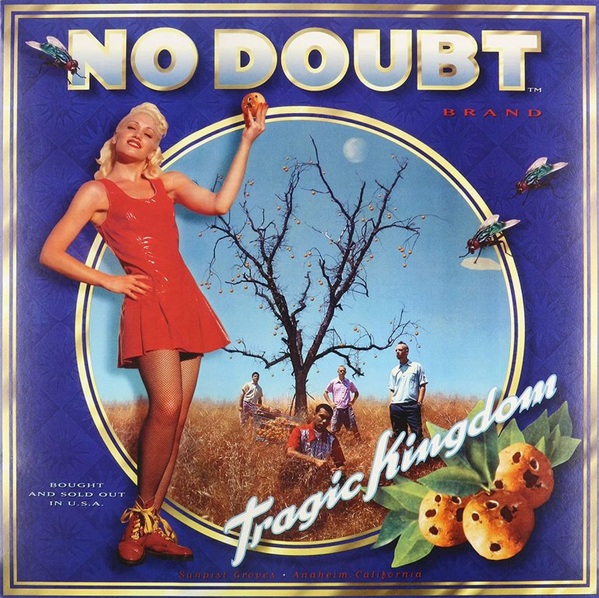
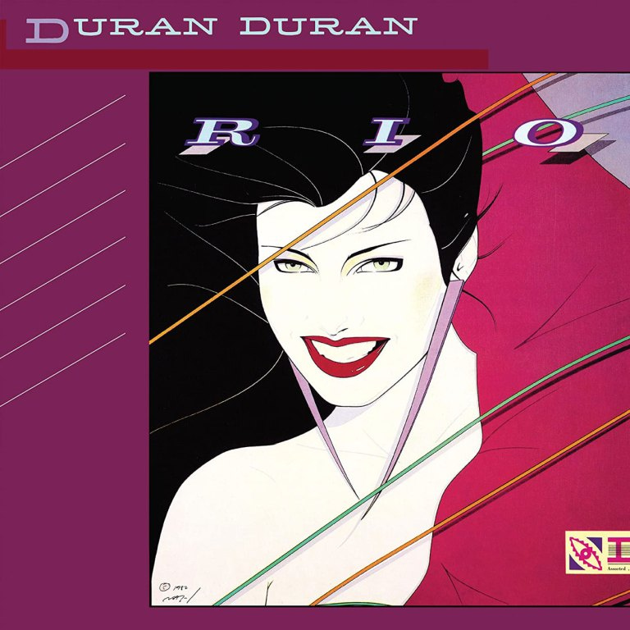
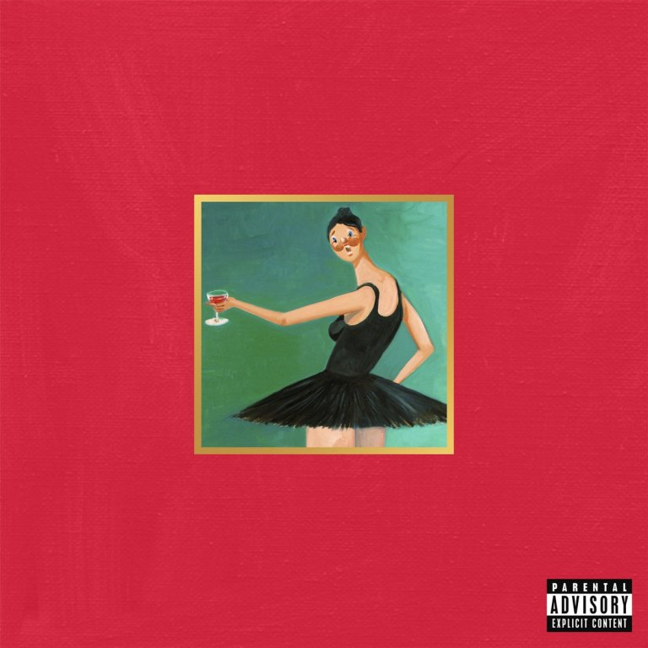
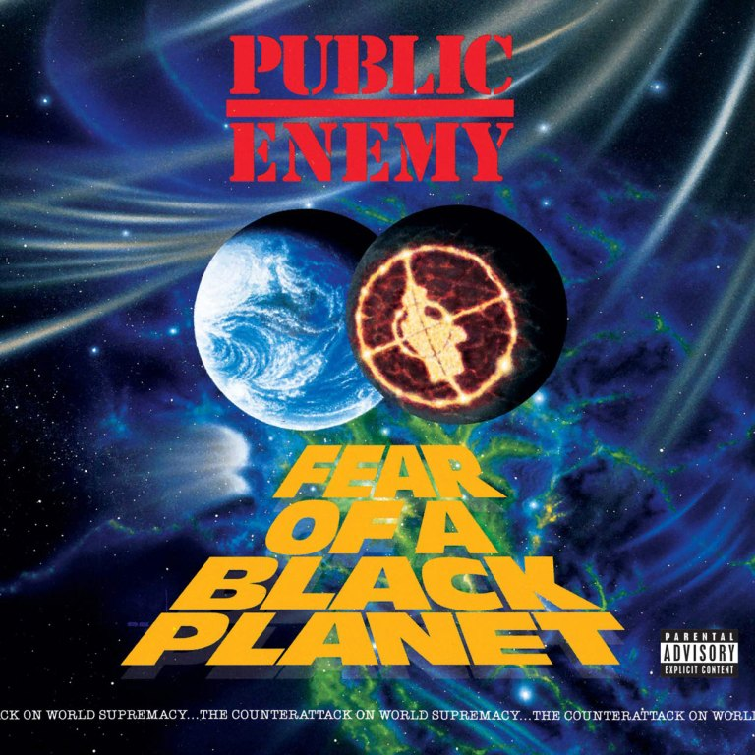


Slide 3
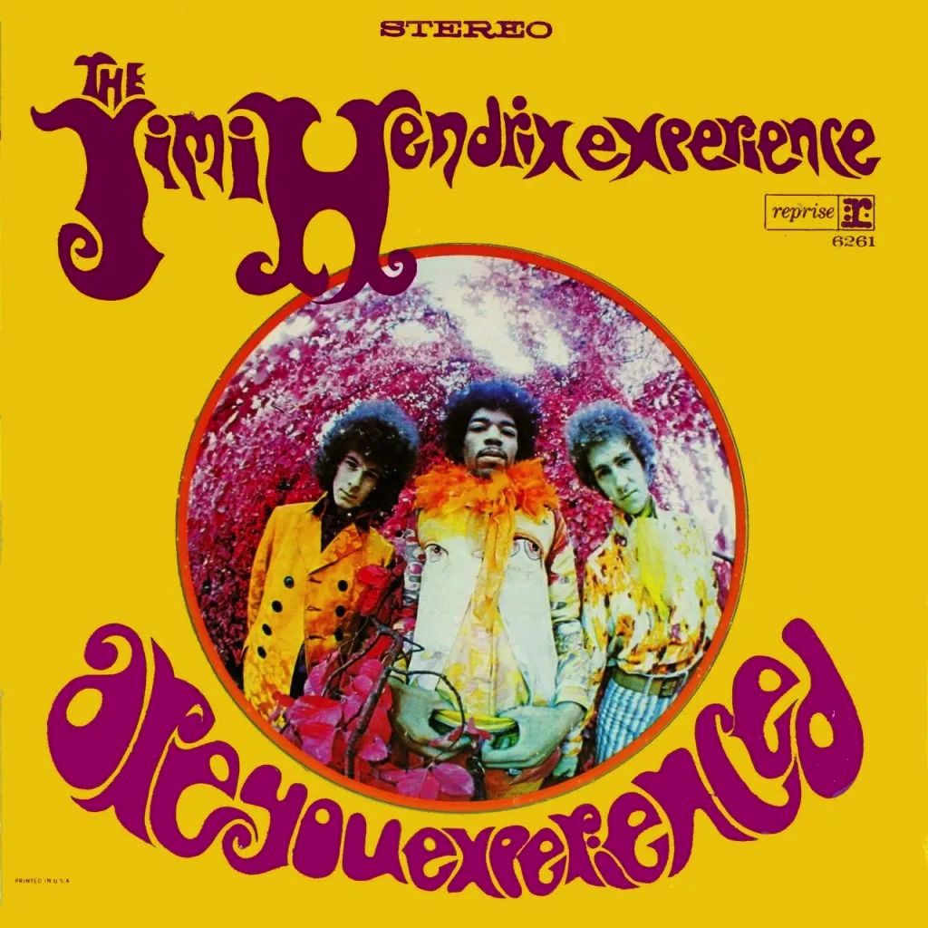
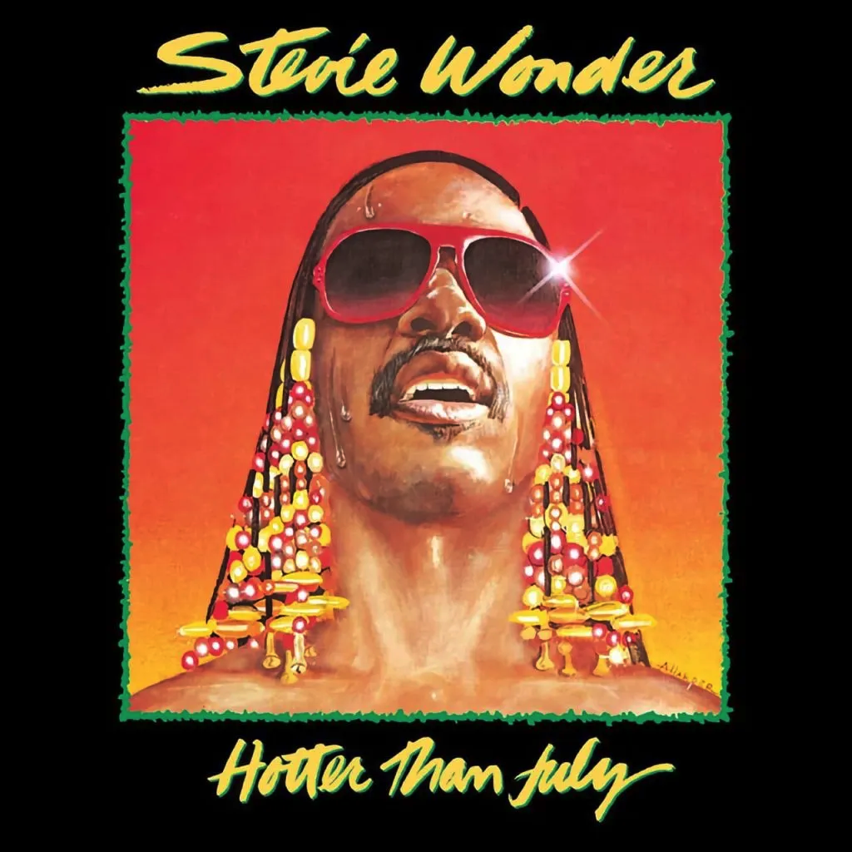

Slide 4
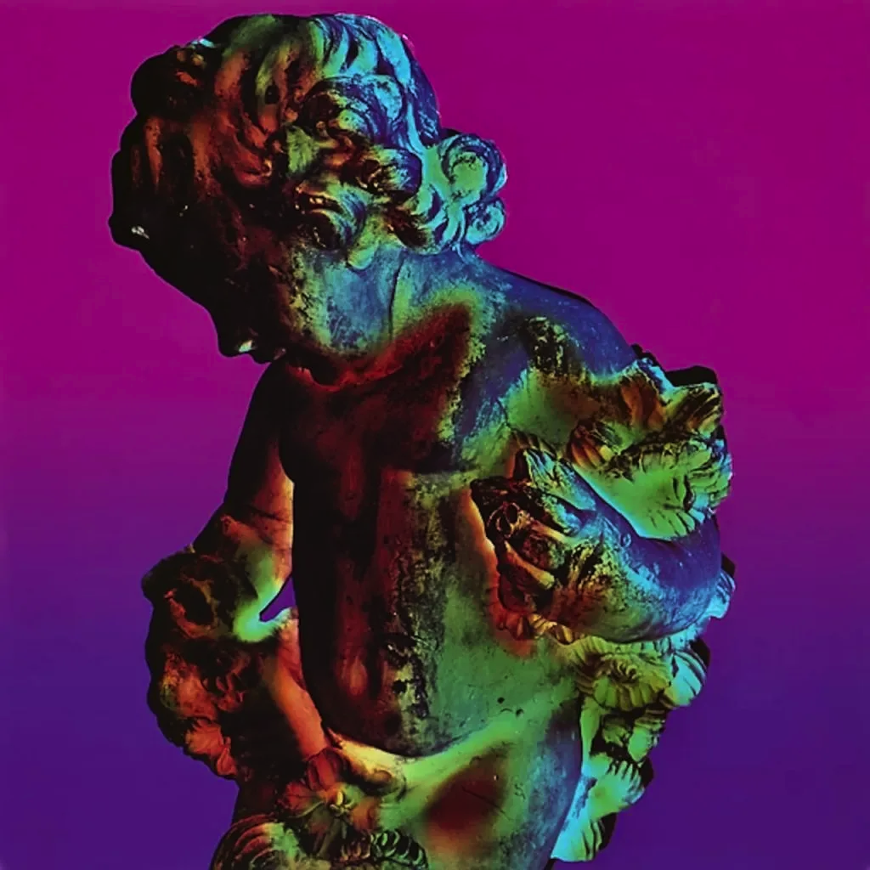
Notes:
New Order Technique 1989

Slide 5
CD Covers – using colour
To create a “great” album cover making bold use of colour, you need to:
square crop the image
know how to manipulate colour
know how to add a colour filter to an image
add text

Slide 6
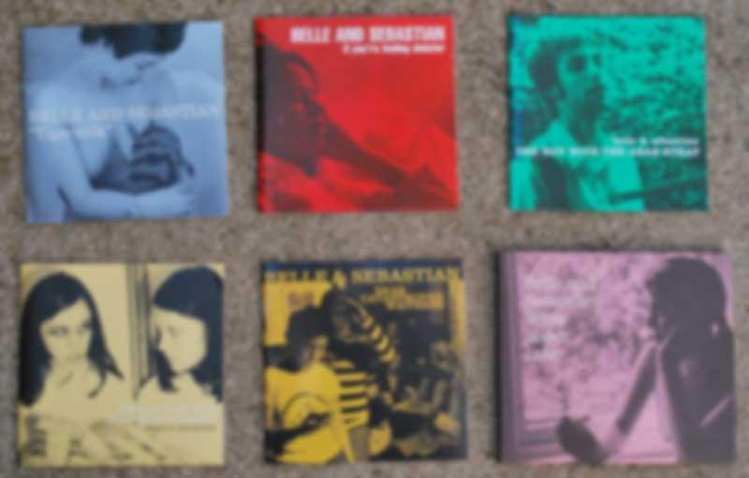
CD Covers – using colour
Colour can be used to help create a visual identity for a band

Slide 7

A black and white image with a colour filter added over the top creates a style used by Belle and Sebastian for all of their albums

Slide 8
Album artwork is used in these slides at small sizes for educational use only.
No claim on copyright is made.

