Slide 1
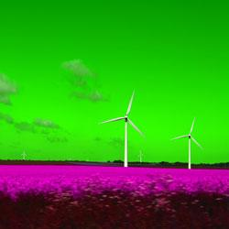
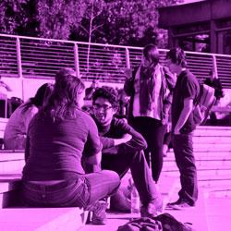
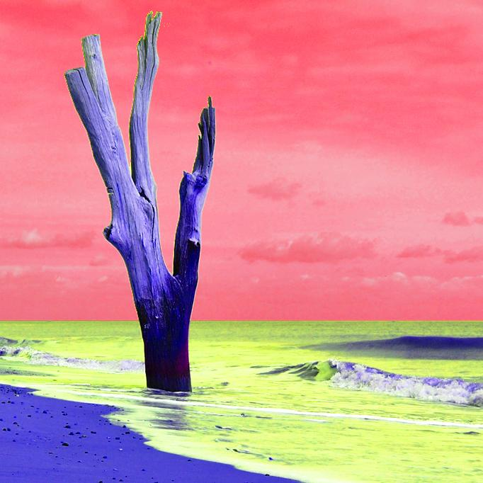
Colour – order of work
Make sure you square crop each time
Manipulating colour – hue and saturation layers
Adding a colour Photo Filter
Two colours – tree and sea
Use text on at least one cover as practice
Save and export images each time

