Slide 1


Crop tool
Text tool
IMPORTANT: click once to use text – don’t drag a text box out
A

Slide 2


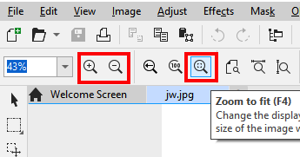
Pick tool
Switch to the pick tool to move objects around
Zoom tool
Switch between zoom in and out at the top
Zoom to fit is really useful

