Slide 1
CD Covers – black and white
In a list of the 50 “greatest” album covers*, 21 use black and white or just two colours.
*Billboard website. Which is American

Slide 2
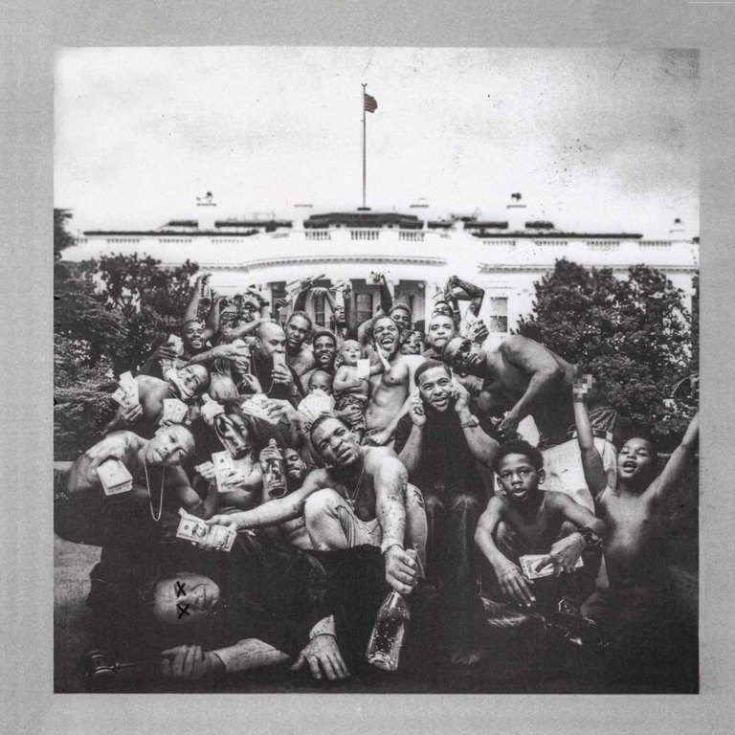
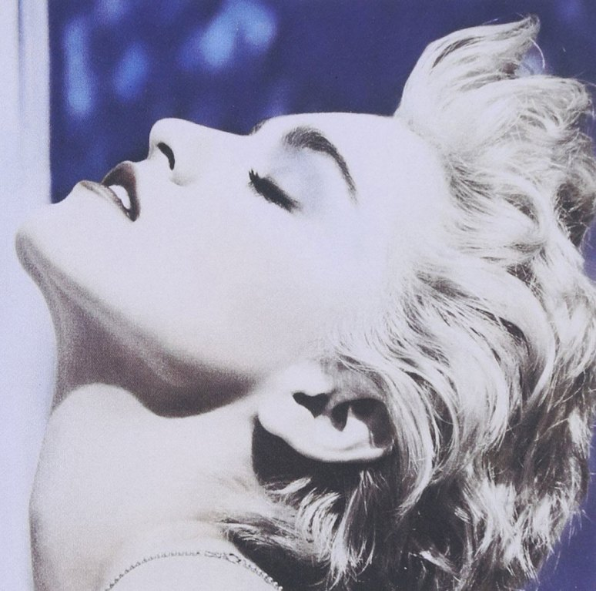
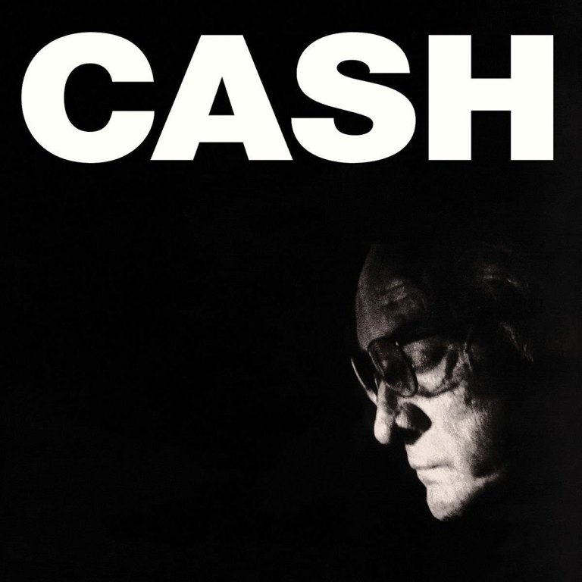

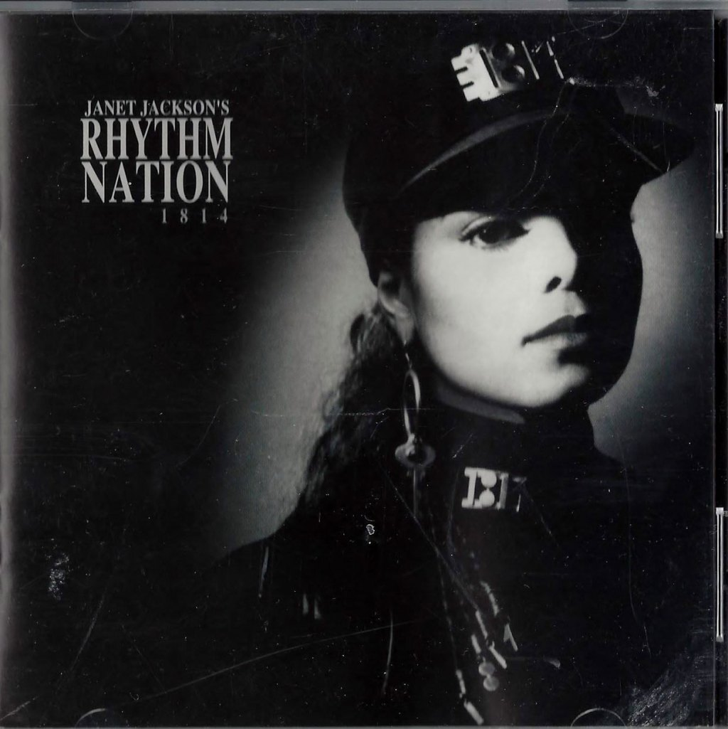
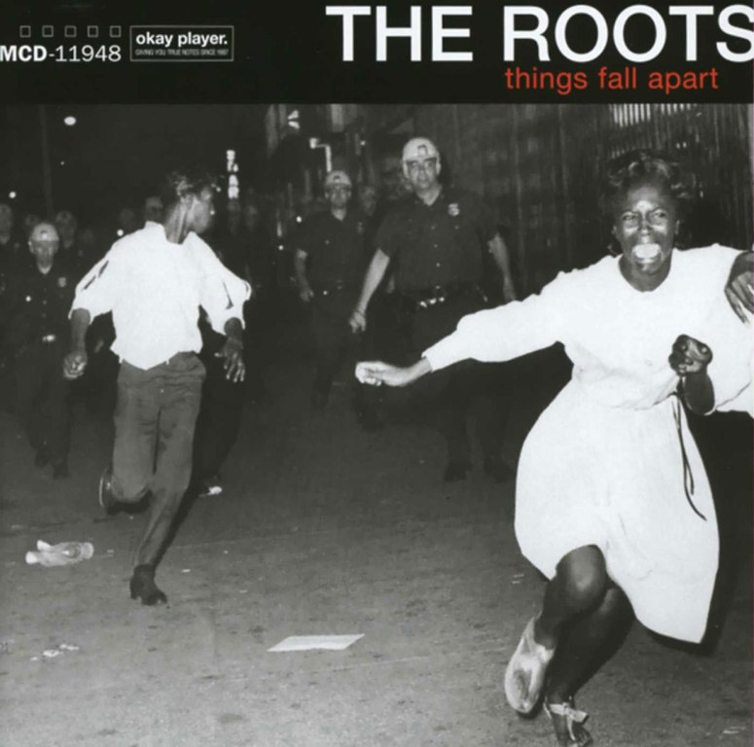

Slide 3

#3
1975

Slide 4
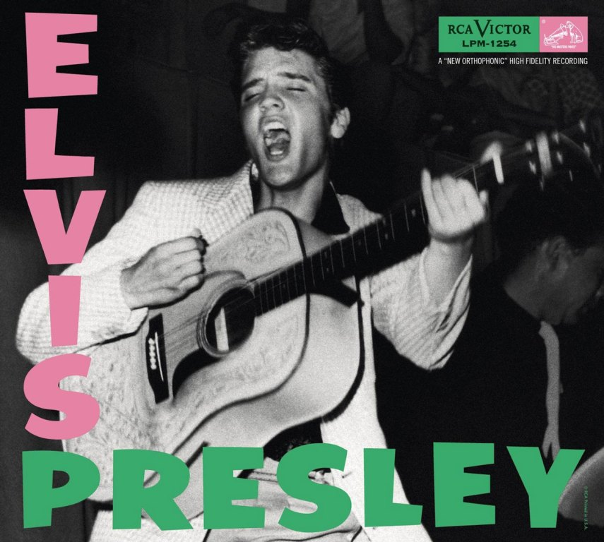

1956
1979

Slide 5
CD Covers – black and white
To create a “great” black and white album cover, you need to:
square crop the image
turn the image black and white
add text
export the finished product

Slide 6
CD Covers – black and white
Album covers are used for vinyl records, for CDs and for artwork on streaming services.
The same cover is used on each one.
A great cover will attract attention and encourage people to play it.

Slide 7
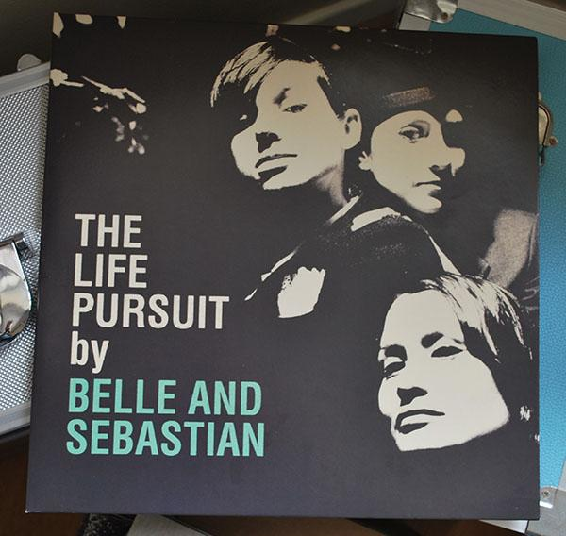


CD
Vinyl record
Spotify

Slide 8
Album artwork is used in these slides at small sizes for educational use only
No claim on copyright is made

