Slide 1
Non-destructive editing
Editing photographs can change the original image
This can lead to the original image being destroyed when the pixels are changed or deleted
One way to avoid this is to use non-destructive editing techniques

Slide 2
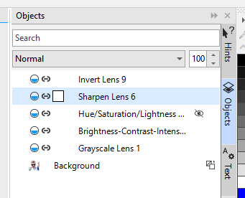
Non-destructive editing
Layers don’t change the original image – they just add adjustment layers on top of it
Each layer can be adjusted, removed, or deleted
None of this changes the pixels in the original image, so if you need to you can go back to the original and start over

Slide 3
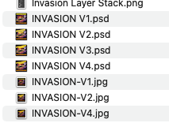

Non-destructive editing
Saving work using a new name can also help
For example, if you decide you don’t like the editing you did, you can go back to an older version
This is called version control
File > Save As > change the name

