Slide 1



Types of image file
There are three main types of image file you need to know about:
JPEG
PNG
GIF

Slide 2
Types of image file
JPEG:
Joint Photographic Expert Group
These are standard photographs and are good for general photo use
They use 16.7 million different colours for individual pixels
They are compressed, so can be saved with a smaller file size
Most of the images you use will be JPEGs

Slide 3
Types of image file
PNG:
Portable Network Graphic
These can use transparency – often the background is made transparent
They are a good choice for logos and other images that need a transparent background when they are complete
Colours don’t work as well with PNGs and they have a bigger file size

Slide 4
Types of image file
GIF:
Graphics Interchange Format
These can use animation (movement). They don’t have to, but can
The can also use transparency
GIFs use a lot fewer colours, but have a smaller file size
They can be a good choice for logos on the web

Slide 5
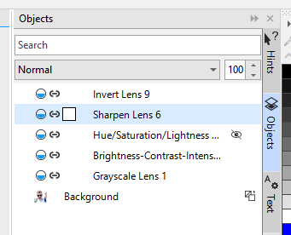
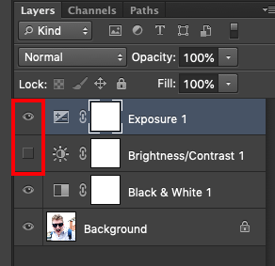
Types of image file
Working file types:
Such as Photoshop (PSD) or Corel files (Corel Draw or Photopaint)
These can’t be used as finished products – they need to be exported first
But the layers can continue to be edited
Always save your work as well as exporting it in case you need to keep editing

