Slide 1
Video Tutorial
Use the clips provided to make a short video explaining how to make a pizza from scratch
You should add titles, captions, at least one still image, and sound of some kind
You will need to find the images and sounds

Slide 2
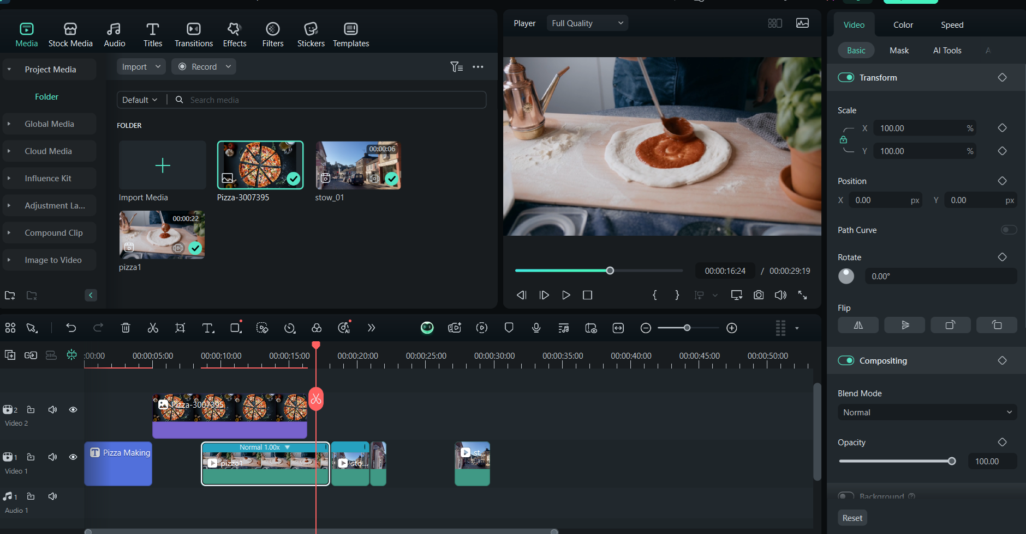
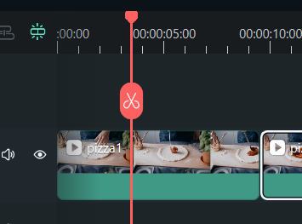
Tabs at top
Preview pane
Timeline at bottom
Red playhead

