Slide 1
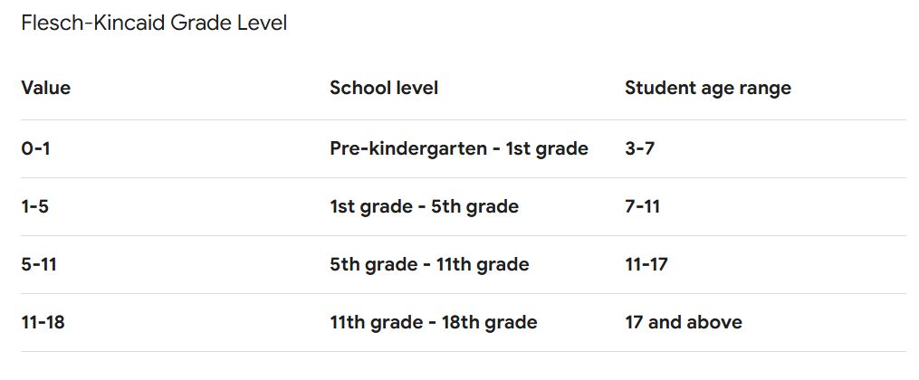
Reading levels
It’s important to make your text easy to read for the target audience
So how complex should it be?

Slide 2
Reading levels
The BBC website is one of the better examples of making text readable
It scores 5-6 on the scale - the reading level of a 10 to 12 year old

Slide 3
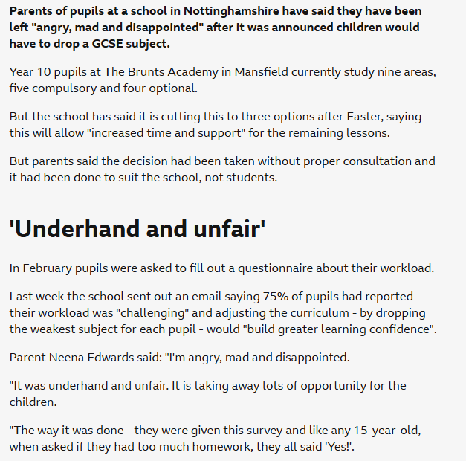
Reading levels
Bold first paragraph
Short paragraphs - one idea per paragraph
Gaps between paragraphs
Headings and subheadings to break up ideas
Simple language

