Slide 1
Video storyboard
Storyboards are planning documents
They show the planned scenes for a video
This will include information about sound and any text captions used

Slide 2
Video storyboard
Your video must include:
at least 2 pieces of video
at least 4 high-quality still images
copyright-free background music or other sound
an idea of timings used for each section – how long will it last for?
annotations to describe what you plan to do

Slide 3
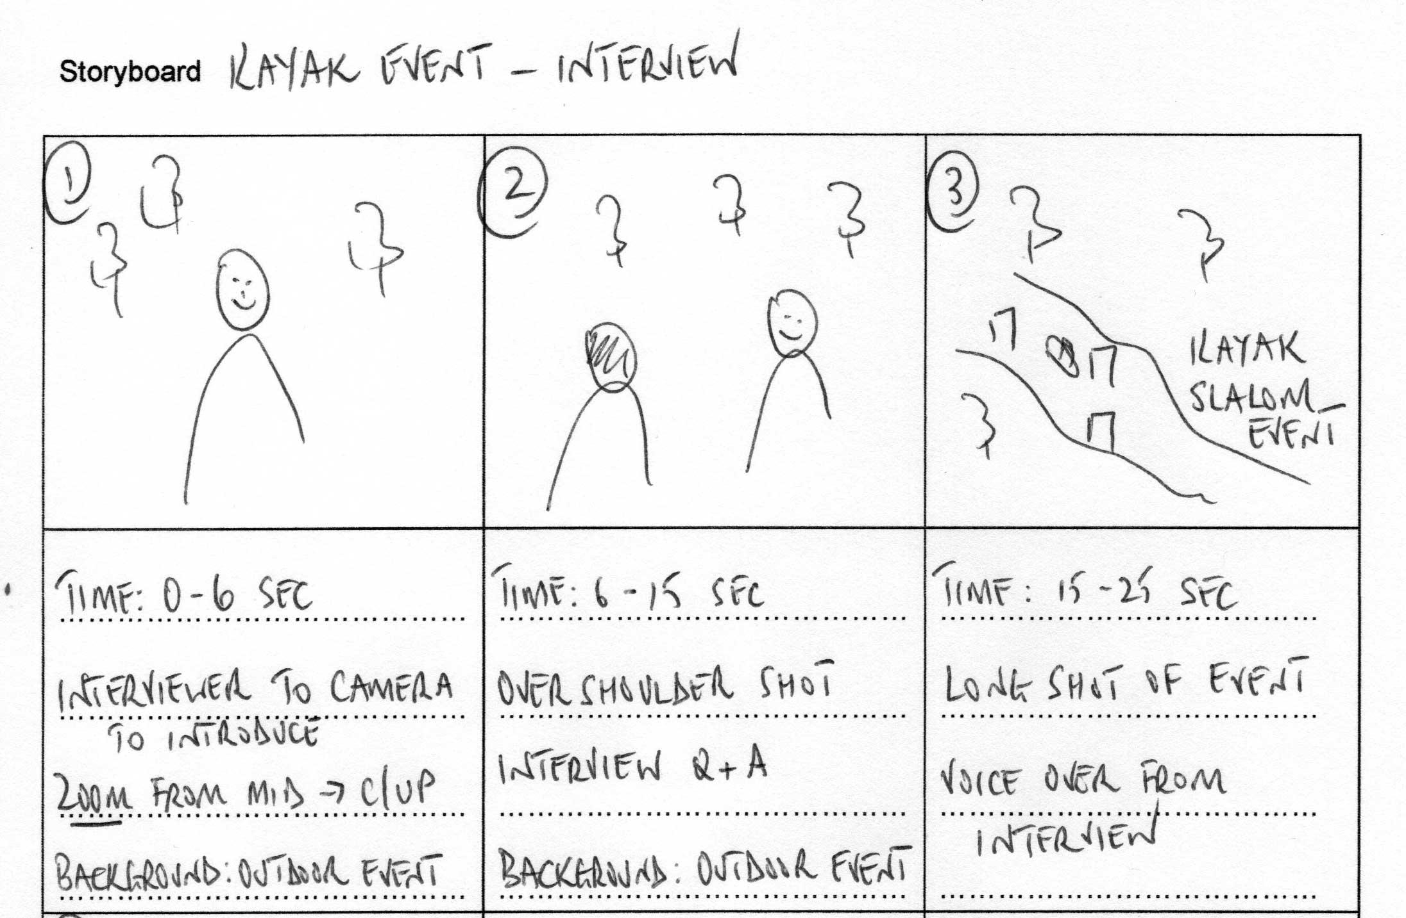
Title
Sketch showing scene content
Scene number
Timings
Type of video shot or still image, including any effects or movement
Audio
Location
The quality of drawing is not important - use shapes and stick figures to show the action if you struggle to draw (like me)

