Slide 1
Interactive Multimedia
Sounds cool – but what does it mean?

Slide 2
Interactive Multimedia
We’re talking about an Interactive Digital Multimedia Product – an IDMP
So, what does Digital mean?

Slide 3
Interactive Multimedia
So, it’s Digital
This means an IT system of some kind – a website, information screen, app etc…
This is the Digital part of an Interactive Digital Multimedia Product (IDMP)

Slide 4
Interactive Multimedia
Interactive: the user can interact with the product
they might enter text on screen or choose options
they might choose their own route through
This means that it’s not the same experience for each user. Navigation needs to be non-linear

Slide 5
Interactive Multimedia
Multimedia: more than one type of media

Slide 6
Interactive Multimedia
Multimedia: more than one type of media
text
images
By media, I mean a way of presenting information
Multi just means more than one, so multimedia products use more than one way of presenting information

Slide 7
Interactive Multimedia
Multimedia: more than one type of media
text
images
audio
video
animation
infographics (charts, maps etc…)

Slide 8
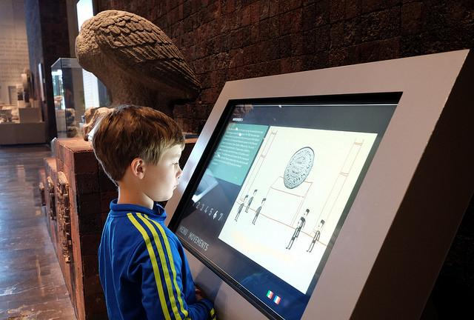
Interactive Multimedia

Slide 9
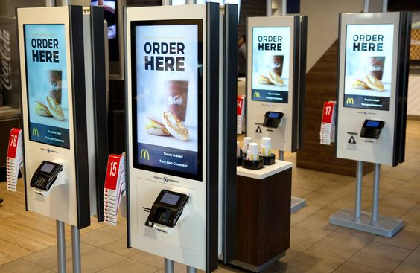
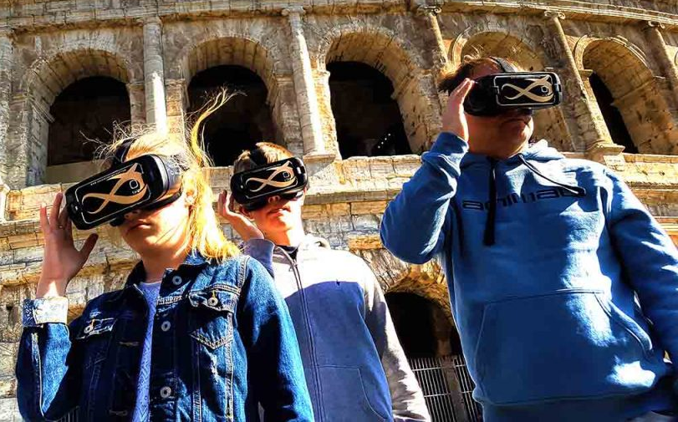
Interactive Multimedia

Slide 10
Interactive Multimedia
Interactive: the user can change where they go based on choices made
Non-linear: the information isn’t always displayed in the same order
Multimedia: more than words. Preferably more than words and images
Digital: using a computer of some kind

Slide 11
Interactive Multimedia
New folder: ICT Multimedia
New document – saved as Multimedia
Write down the meaning of the term IDMP
Describe what we mean by the words:
  Interactive
  Digital
  Multimedia
List 4 types of media that could be included in an IDMP
Build up a set of examples of interactive digital multimedia products. Use screenshots to demonstrate the different types of product and add text to describe them

