Slide 1
What is an IDMP?
Interactive Digital Multimedia Products are a big deal
They are:
digital
multimedia
interactive
These can be on computers, on apps or in all sorts of other places

Slide 2
What is an IDMP?
Digital: made on, stored on and/or used by computers

Slide 3
What is an IDMP?
Multimedia: uses more than one type of media
So, not just text
By “media” we mean a way of presenting information – so text and pictures are both examples of media, as are video or audio
We don’t mean social media websites or apps

Slide 4
What is an IDMP?
Multimedia: uses more than one type of media
Can include:
text
still images
video
sound
animation

Slide 5
What is an IDMP?
Interactive: the person using the product is in control
There has to be more than one route through the product - it has to be non-linear
The user has to be able to make choices to create their own route through. They might be able to go back to the start. It can’t just go in the same order each time

Slide 6
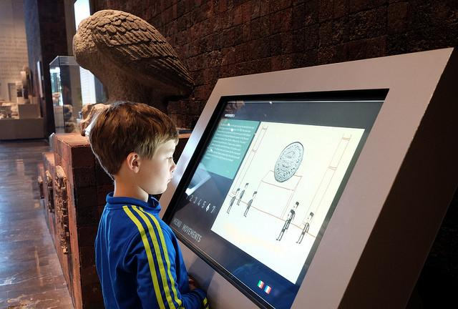
What is an IDMP?
Interactive Digital Multimedia products are used for all sorts of things...

Slide 7
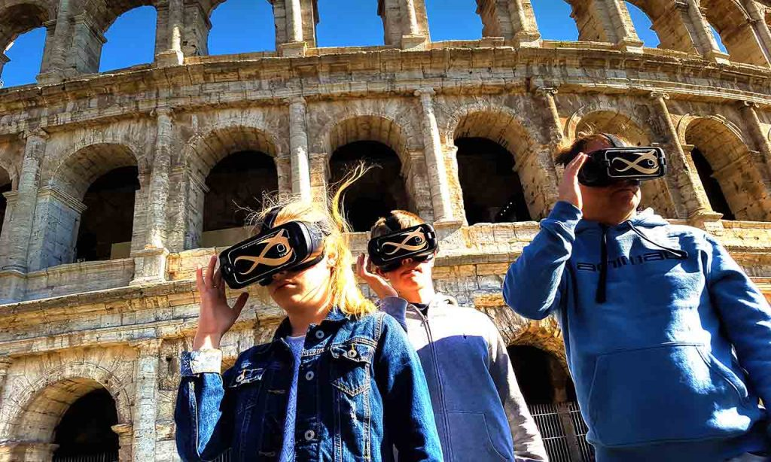

Slide 8
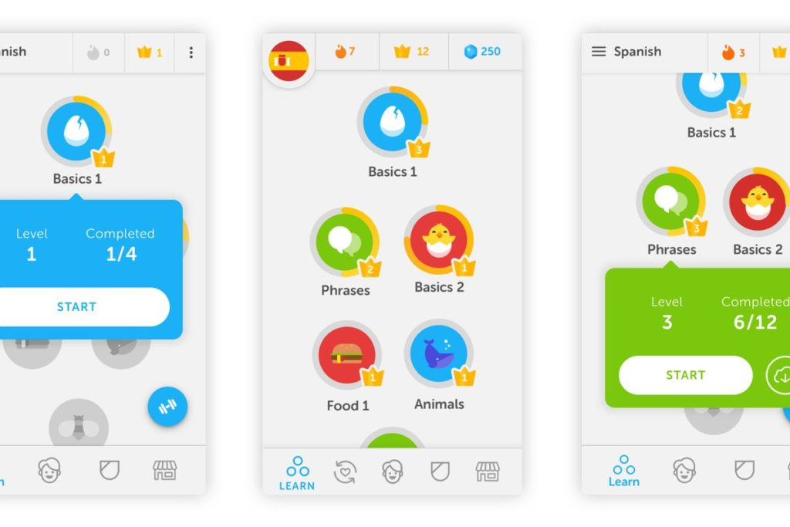

Slide 9
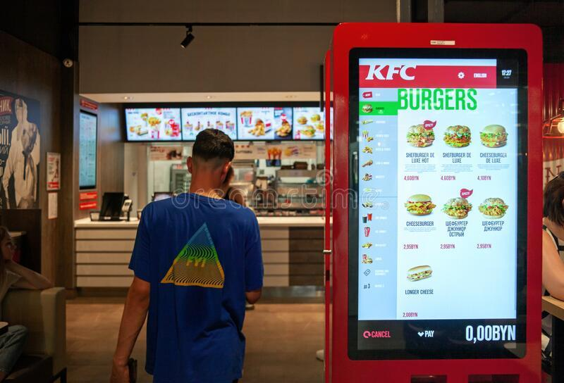

Slide 10
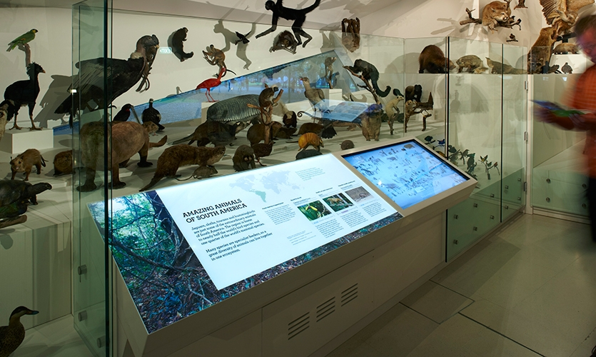

Slide 11
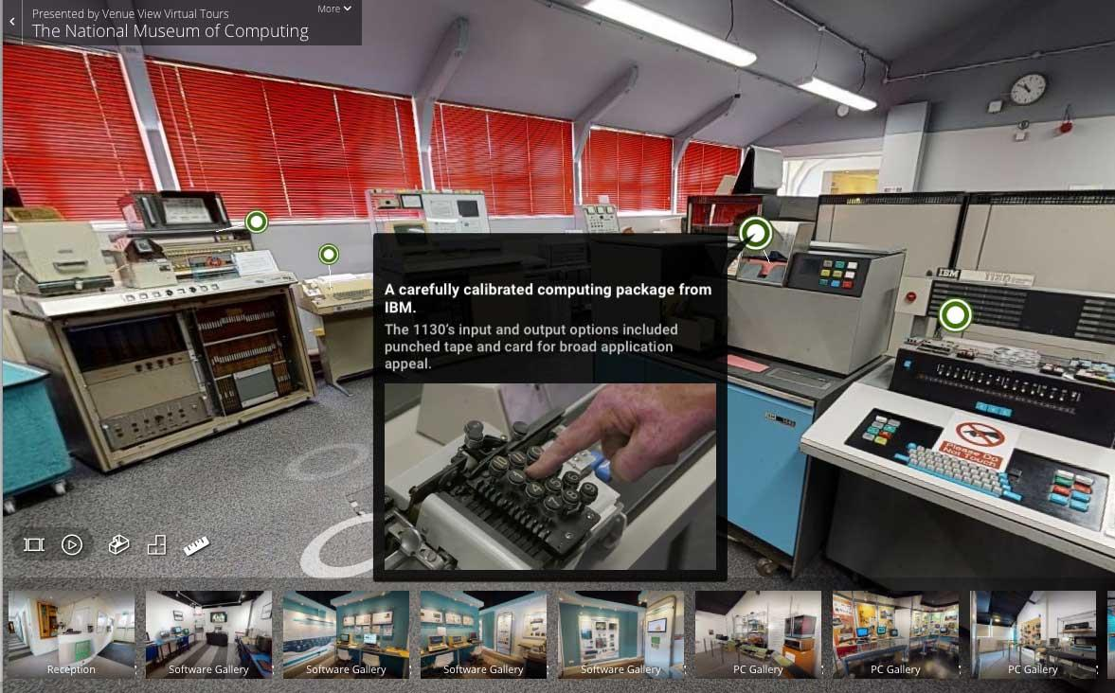

Slide 12
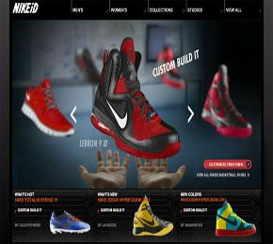
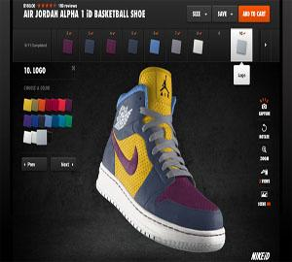

Slide 13
What is an IDMP?
In each case, the user has the choice of route through the product
Interactive: user decides their own route
Digital: made on, stored on and/or used by computers
Multimedia: more than one media
Product: a “thing” that does a particular job – an app, website, or other product

