Slide 1
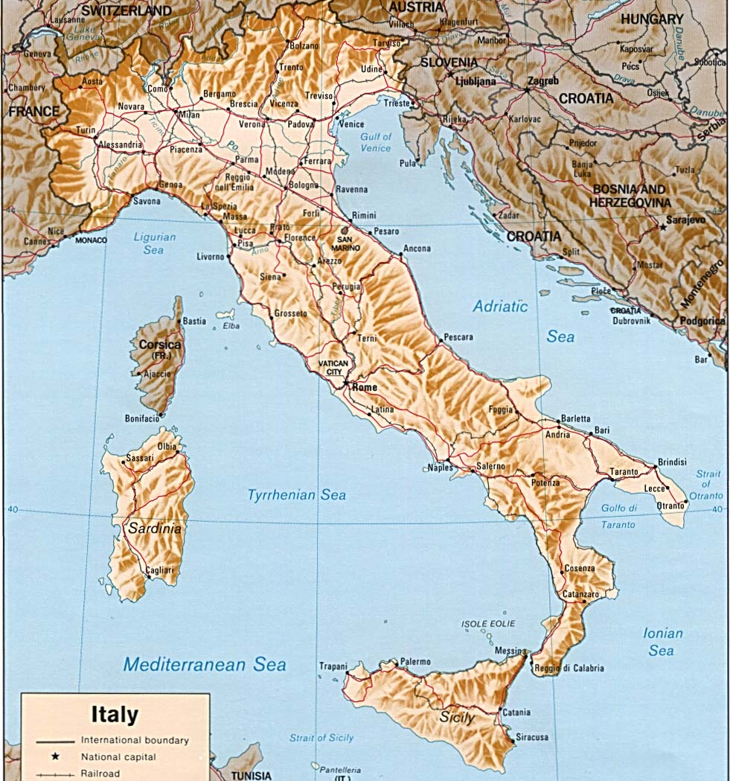
Turin
Milan
?
Calabria
Should Joey stay or should he go?
Brindisi
Aliano

Slide 2
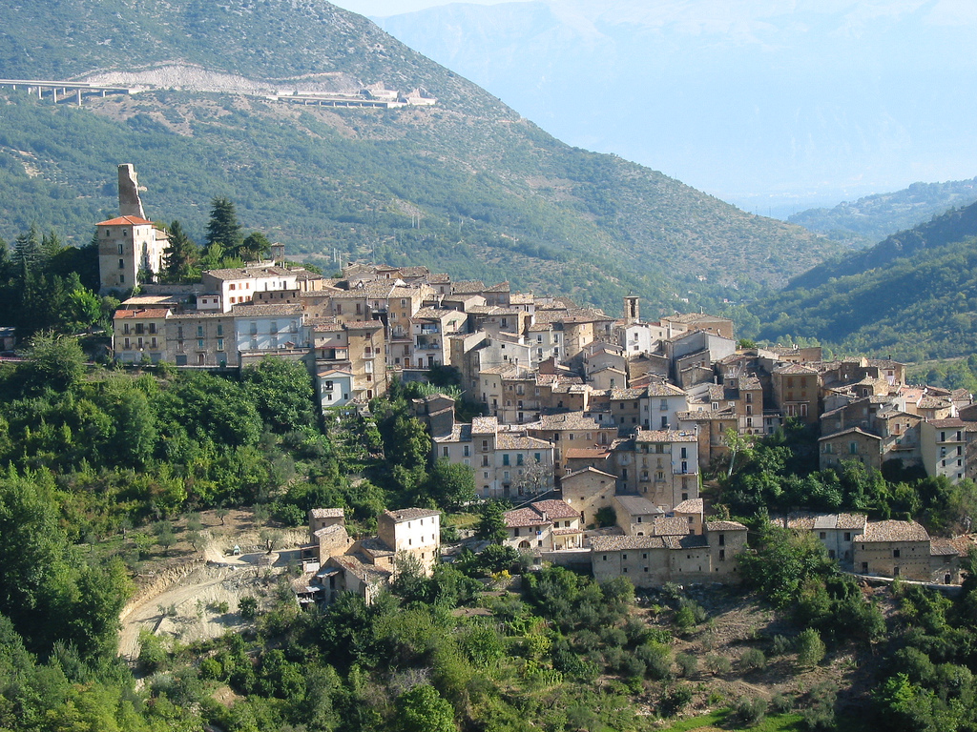
Aliano
Photo by pizzodisevo, used under a Creative Commons license from his Flickr photostream

