Slide 1
Dunwich: Should it be Protected?

Slide 2
Dunwich - Opinions
Should Dunwich be protected from the sea?
Present, using whatever methods you want, a range of opinions about protecting Dunwich from erosion and flooding
You have 30 minutes for this task

Slide 3
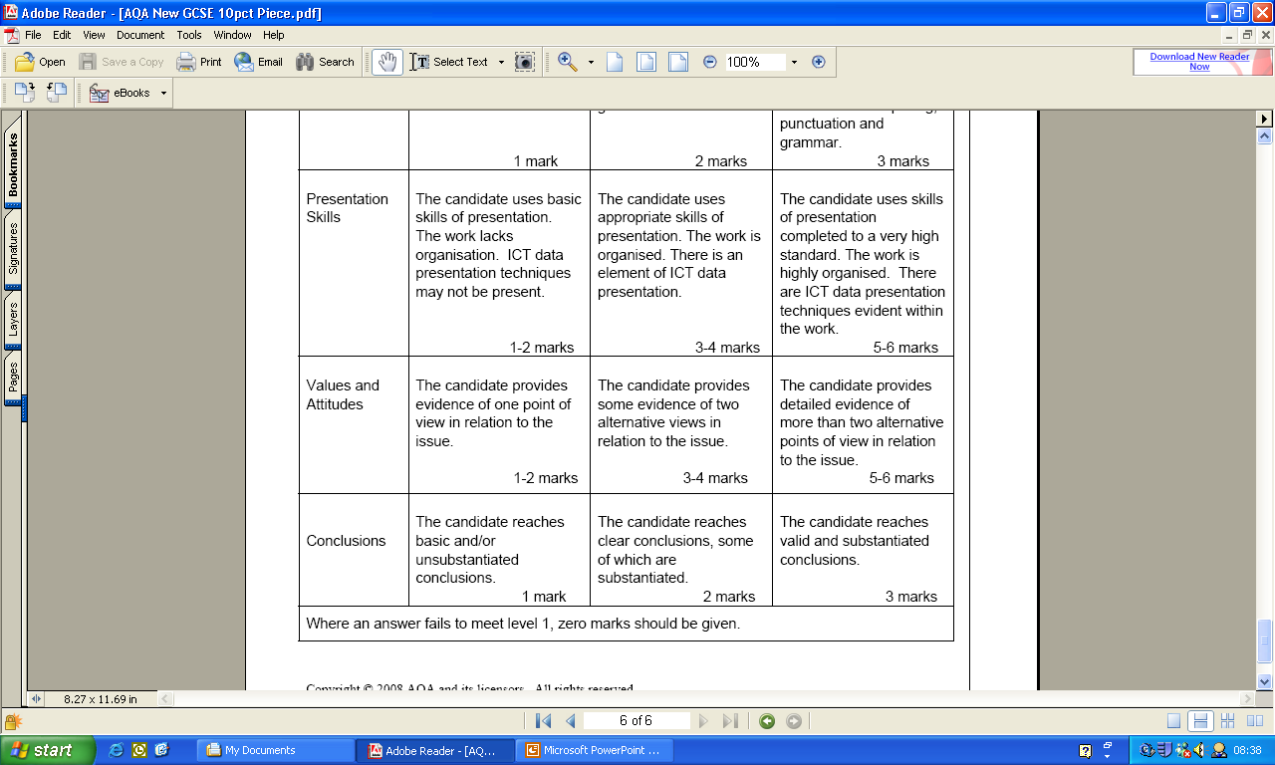
Marking the Work

Slide 4
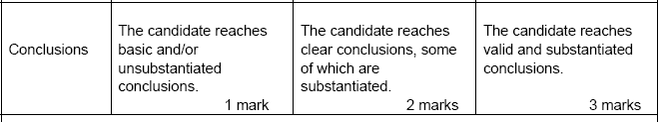
Conclusions
State whether you think places like Dunwich should be protected. Give reasons for your answer.

