Slide 1

Fairtrade – am I bothered?

Slide 2
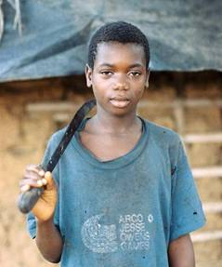
Fairtrade – am I bothered?
Fairtrade is about doing trade in a way that’s fair for everyone. When you spot the Fairtrade Mark on a product, it means that farmers in developing countries have been paid a fair and stable price for their crop.
Fairtrade is a good thing for farmers like me, we earn more, but it also means we get help and advice with farming practices and learn new skills, becoming better farmers.
What are the advantages of Fairtrade?

Slide 3
Fairtrade – am I bothered?
Build community facilities together
We know a bit more about how other people live
It makes us feel good
More money
Clean water supplies
Better working conditions
What are the advantages of Fairtrade?
Better diet so people are healthier and live longer
Farmers know what the price will be so they can plan for the future
Improved farming methods
Less child workers
People are in charge of their own lives
Cleaner environment – people are in charge themsevles
Children can go to school

Slide 4
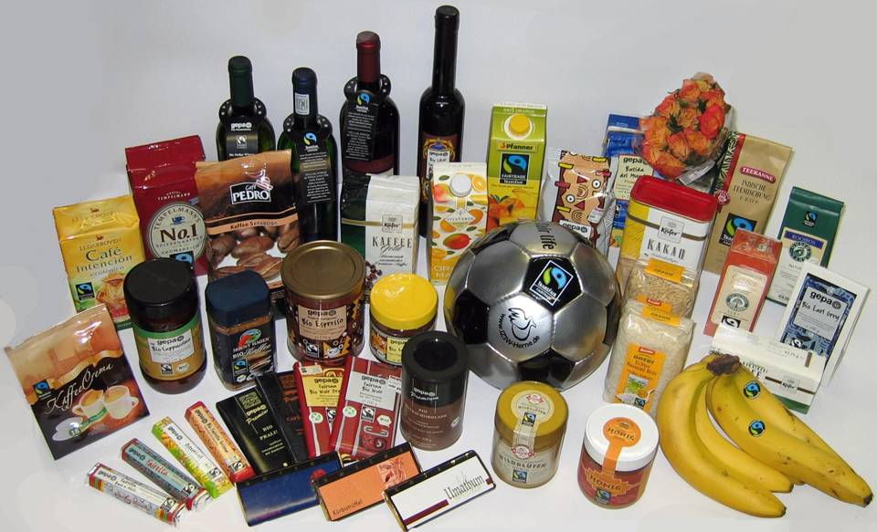
Fairtrade – am I bothered?
Before you've finished your breakfast this morning, you'll have relied on half the world

Slide 5
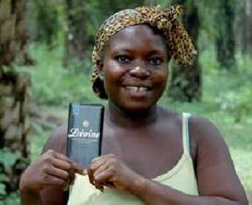
Fairtrade – am I bothered?
We rely on the money we get from cocoa for everything: for food, clothes, medicines, and school fees. Getting payment for our cocoa beans used to be very hit and miss. When we didn't get paid, we went without. Kuapa Kokoo pays all its farmers a fair price for their crop, in cash, and on time. I am very happy: since I joined Fair Trade I can afford to send my children to school.

